Slide 1
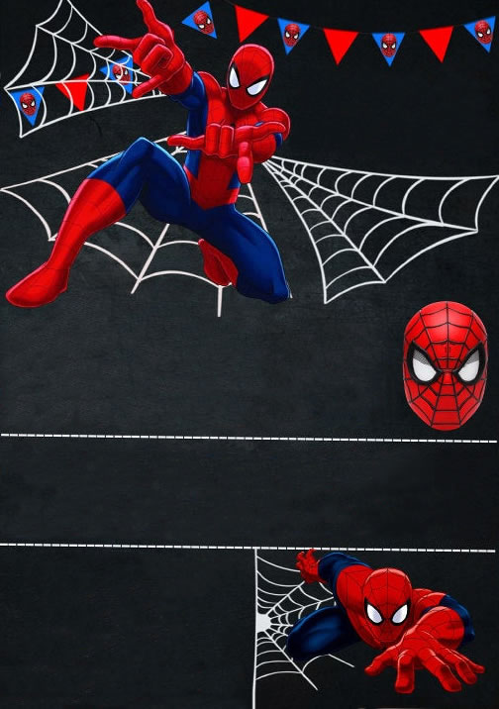
CALLING ALL
SUPERHEROES!
MAICOL
5
IS TURNING
2
0
2
0
SATURDAY
16
2:00 PM
AUGUST
th
-
4:00 PM
Our Home
898 Stringtown st.
Coventry, FL 7895
rsvp: Mom 890-343-4454
www.megaidea.net

