Slide 1
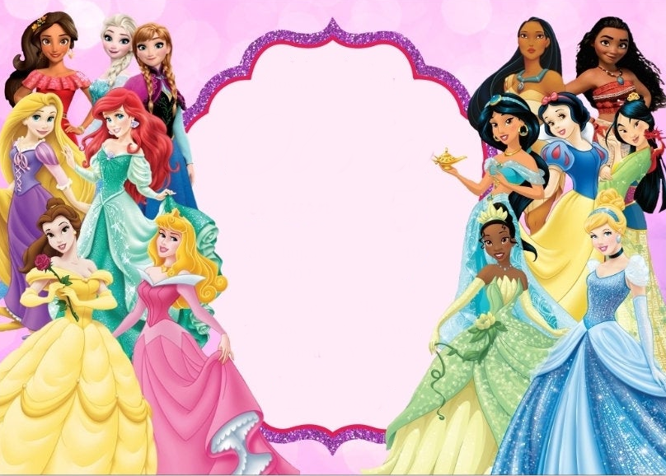
Join us for a Royal
celebration!
Maryori
6
is turning
SUNDAY, AUGUST 15
2:00 PM - 4:00 PM
JESSICA'S HOUSE
182 BIRTHDAY AVE
CALIFORNIA, NY 24105
RSVP TO MONICA
123.456.7890
www.megaidea.net

